Slide 1
Treatment of Metastatic Luminal Breast Cancer
Dr Esfahani

Slide 2
Molecular subtypes of breast cancer
Molecular and genetic differences in breast cancers may be useful in guiding the development of new drug therapies
4 major molecular subtypes:
Luminal A
Luminal B
Basal-like/triple negative
HER2-enriched

Slide 3
Luminal A breast cancer is hormone-receptor + (ER and/or PR+), HER2 -, and has low levels of Ki-67
Luminal A accounts for 73% of breast cancer cases, luminal B for 11% , triple negative for 12% and HER2-enriched for about 4%, according to American Cancer Society

Slide 4
In general, breast cancer can be broken down into three biologic subgroups, each of which has a direct bearing on treatment choices:
1) those that express the estrogen receptor (ER)
2) those that express HER2 (±ER expression)
3) triple-negative

Slide 5
Up to 5 % of breast cancer have metastatic disease at presentation
30 % develop distant metastatic disease

Slide 6
Systemic therapies for metastatic HR+/Her2- breast cancer
Endocrine therapy
Deplete estrogen AI
Target the ER SERMs, SERDs
Targeted agents
Phosphoinositide 3-kinase [PI3K]
Mechanistic target of rapamycin [mTOR]
Cyclin-dependent kinase [CDK] 4/6
Poly(ADP-ribose) polymerase (PARP)
Chemotherapy

Slide 7
Metastatic at presentation or first recurrence should be biopsied
15% of metastatic cancers may have discordant ER compared with primary cancer
Re-testing the receptor status of recurrent disease be performed, especially when it was previously unknown, negative, or not overexpressed

Slide 8
(IHC) staining of 0 to <1 % considered negative
≥10 % positive
ER 1 to 9 % IHC staining are considered positive and ET should be considered, but may be less likely to be effective

Slide 9
Endocrine therapy
Systemic treatment of breast cancer recurrence or stage IV disease prolongs survival and enhances quality of life (QOL) but is not curative
Since ET (±targeted agents) less toxic than chemotherapy, with same outcomes, it is preferable to begin treatment with ET

Slide 10
Patients with with HR–positive breast cancer, or with prior positive HR results: a course of endocrine therapy is reasonable, regardless of result of recent HR assay
Reserving chemotherapy for refractory to ET or extensive symptomatic visceral involvement

Slide 11
Chemotherapy
End-organ dysfunction can include pulmonary symptoms
Dyspnea
evidence of pulmonary lymphangitic disease
elevated liver function tests
Visceral metastasis without these findings, not indication for chemotherapy

Slide 12
After reduction of the patients' symptoms, discontinue chemotherapy and start ET
There are no data that combining ET (with or without targeted agents) with chemotherapy improves overall survival

Slide 13
First-line ET: progression ≥12 months from end of adjuvant ET and de novo metastatic breast cancer
Second-line treatment: progress within 12 months of djuvant ET and progress on first-line ET

Slide 14
Targeted Therapy for Breast Cancer

Slide 15
CDK 4/6 inhibitors
Retinoblastoma tumor suppressor protein: key cell-cycle checkpoint , prevents G₁-phase cells from entering S-phase
Cancer cells overcome pRb-dependent growth suppression via phosphorylation and inactivation of pRb function by cyclin-dependent kinase (CDK) 4 or CDK6

Slide 16
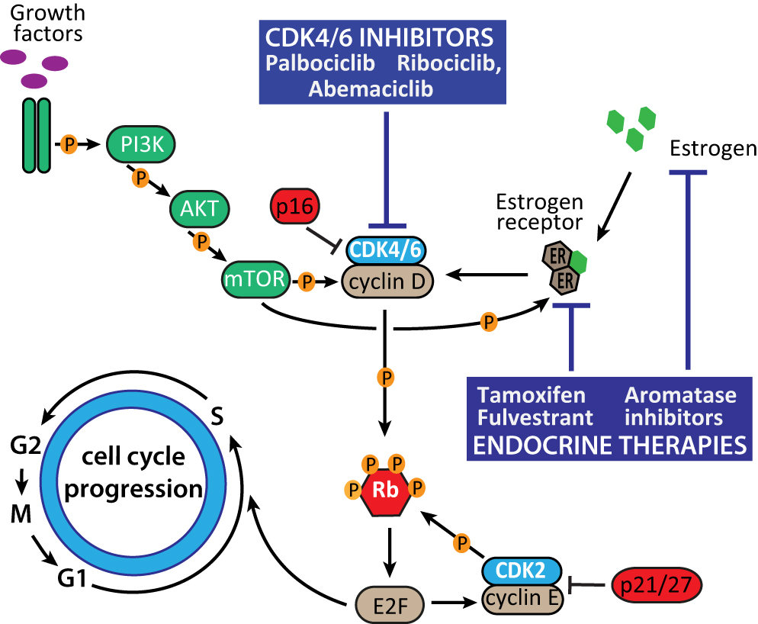

Slide 17
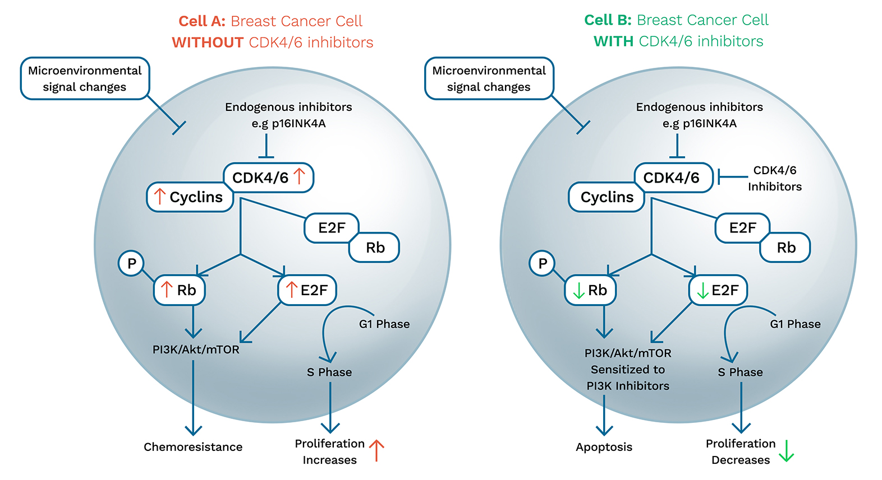

Slide 18
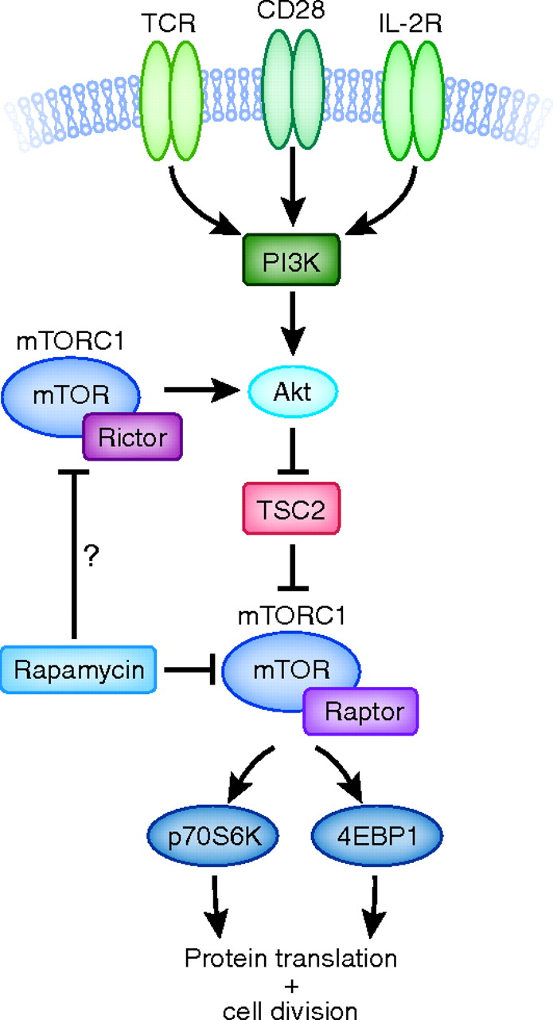
PI3K/AKT/mTOR signaling pathway

Slide 19
PALOMA 2: Palbociclib + letrozole, phase III, 666 postmenopausal HR-positive, HER2-negative metastatic patients compared with letrozole alone
Not received prior treatment for advanced
PFS (24.8 vs. 14.5)
Objective RR (42 vs. 35%)
Neutropenia (66.5% vs. 1.4%)

Slide 20
Monaleesa 2 trial: Ribociclib + letrozole first-line postmenopausal
PFS (25.3 vs. 16.0)
Improved ORR of 43%vs.29%
MONARCH 3 trial: abemaciclib + AI (letrozole or anastrozole)
Improved PFS,
ORR (59% vs. 44)
Adverse events: diarrhea (9.5% vs.1.2%), neutropenia (21.1% vs. 1.2%)

Slide 21
MONALEESA-3
Ribociclib + fulvestrant vs fulvestrant: improved in PFS and OS (21 vs 13) / (57.8% vs 45.9%)
MONALEESA-7 trial, 672 pre- or perimenopausal women
Ribociclib or placebo + goserelin + AI or tamoxifen
PFS: 24 versus 13 m, OS (70% vs. 46%)
AI + CDK 4/6 inhibitor: In post or premenopausal women receiving ovarian ablation/suppression improved PFS relative to an AI alone

Slide 22
FIRST-LINE THERAPY
progress >12 months after end of adjuvant ET and patients who present with de novo metastatic breast cancer are offered first-line ET

Slide 23
No randomized trials for optimal sequencing of various targeted agents or their combination in patients receiving ET
Indirect comparisons suggest improved outcomes with CDK 4/6 inhibitors and AIs relative to other ET and targeted agents
Additionally, side-effect profile of CDK 4/6 inhibitors appears more tolerable than that everolimus or alpelisib

Slide 24
In meta-analysis, no statistically significant differences in PFS were found among the three CDK 4/6 inhibitors in combination with an AI
Palbociclib and ribociclib higher neutropenia
Abemaciclib more diarrhea
Ribociclib higher LFTabnormalities and can cause QTc prolongation

Slide 25
FALCON tria: 462 metastatic ER+ naive fulvestrant500 mg /anastrozole PFS (16.6 versus 13.8 months)

Slide 26
Based on the above data, NCCN : AI + CDK 4/6 inhibitors as category 1 first-line option
Fulvestrant + CDK 4/6 inhibitor is an appropriate alternative, particularly for prior treatment with Ais
Single-agent fulvestrant or AI alone for low disease burden or less likely tolerate combination treatment

Slide 27
Second Line Therapy
Women who progress on adjuvant ET or within 12 months of completion, or progress on first-line treatment for metastatic disease
For previous tamoxifen: AI plus a CDK 4/6 inhibitor (AI in select pt)
Fulvestrant-based treatment is appropriate option for previous aromatase inhibitor (AI)

Slide 28
Progression on AI monotherapy: Fulvestrant plus CDK 4/6 inhibitor (PALOMA3 trial, MONARCH 2, MONALEESA-3)
If previously treated with a CDK 4/6 inhibitor, base on PIK3CA status:
PIK3CA wild-type tumor: fulvestrant monotherapy or everolimus-based combinations
PIK3CA-mutant tumor: fulvestrant plus alpelisib
Everolimus plus ET often as a later-line option

Slide 29
Alternatives to fulvestrant
Everolimus plus Exemestane: BOLERO-2 trial, 724 pt progressed on anastrozole, improvement in PFS (7 versus 3 months and ORR
Everolimus plus tamoxifen 111 pt previously treated with an AI GINECO

Slide 30
PI3K/AKT/mTOR pathway : cell growth, survival, and angiogenesis.
Mutations in PIK3CA, which encodes alpha subunit of PI3K
Mutations detected in over 40 % of ER+ breast cancers

Slide 31
Fulvestrant plus alpelisib Improved PFS and OS
Adverse events : hyperglycemia (37 vs 0.7 %), rash (10 vs 0.3 %), and diarrhea (7 and 0.3 %)

Slide 32
Tamoxifen monotherapy
Abemaciclib monotherapy
Megestrol acetate and medroxyprogesterone acetate: response rate of 25 percent and median duration of response of 15 months
Estrogens
Androgens response rates of 10 to 20%

Slide 33
BRCA mutation carriers PARP inhibitor
Bevacizumab+ Letrozole improve progression-free survival in one trial

Slide 34
In general, patients who have progressed after multiple lines of ET should receive chemotherapy

Slide 35
Esetaxel-Capecitabine
improved PFS among women with HER2-negative, hormone receptor-positive metastatic breast cancer, according to study results presented at the virtual San Antonio Breast Cancer Symposium.
phase 3 CONTESSA trial all-oral regimen for women who previously received a taxane, according to the researchers.

Slide 36
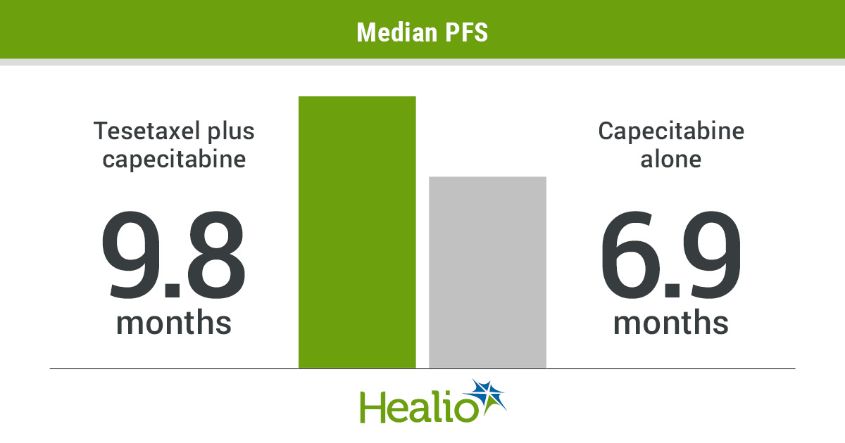

Slide 37
Olaparib
TBCRC 048 trial presented during the ASCO20 Virtual Scientific Program
Single-agent olaparib meaningful response in somatic BRCA1/2 or germline PALB2 mutations
50% objective response rate

Slide 38
Pembrolizumab
Heavily pretreated metastatic breast cancer
High tumor mutational burden
Phase 2 results from the TAPUR basket study

Slide 39


Slide 40
Dalpiciclib-fulvestrant combination improves PFS in advanced breast cancer
DAWNA-1 study: 361 patients ECOG 0 or 1 who received up to one prior line of chemotherapy for recurrent or metastatic disease
150 mg oral dalpiciclib daily on days 1 to 21 of each 4-week cycle plus 500 mg fulvestrant

Slide 41
